Slide 1
FUTURE INSTITUTE OF ENGINEERING AND MANAGEMENT
CC – 148
UNDER
MAKAUT, WB.
Vehicle Speed Measurement Device
PRESENTED BY:
ROHAN PRAMANIK (14800320026)
APURBA SAMANTA(14800320010)
COURSE NAME: B TECH
SEMESTER: 6TH
AY: 2022-23

Slide 2
CONTENTS
Introduction
How Does It Works
Components
Key Features
Applications
Benefits
Challenges
Future Scope
Conclusion

Slide 3
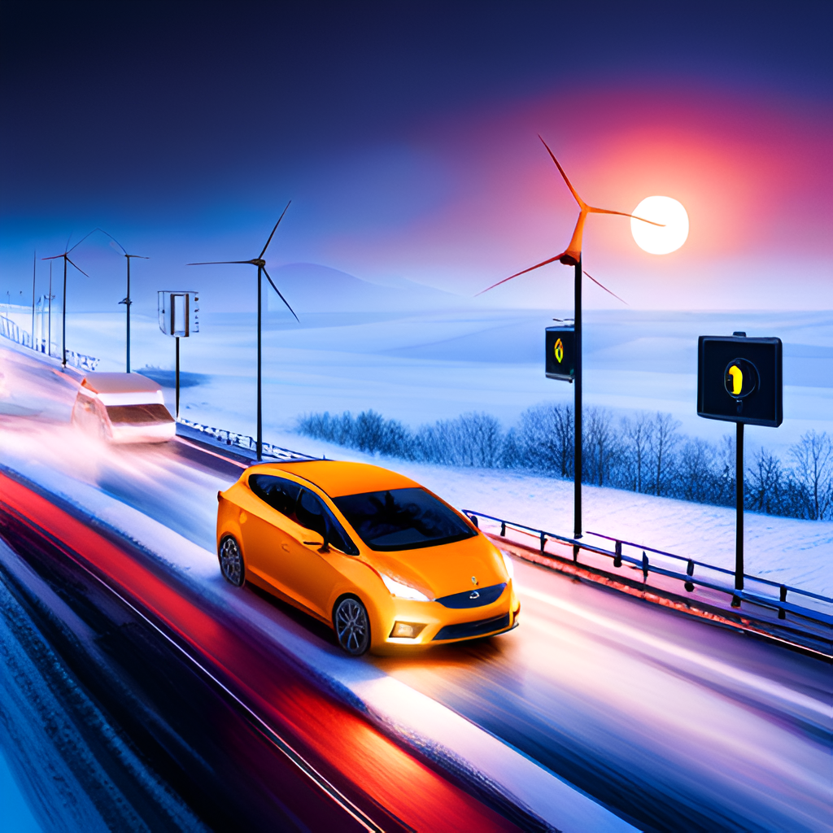
Introduction
The Vehicle Speed Measurement Device project is an innovative solution to the problem of accurately measuring the speed of vehicles on the road. This device uses technology to provide accurate readings, making it a valuable tool for law enforcement agencies and transportation departments.
The device is designed to be easy to use, with a simple interface that allows users to quickly and easily access the information they need. It is also compact and portable.

Slide 4
How Does It Work?
The System works withhe two IR sensors are strategically positioned on the road or track, with a measured distance between them. These sensors are typically installed parallel to each other and perpendicular to the direction of the vehicles. As a vehicle passes through the sensors, the first IR sensor detects the presence of the vehicle and triggers a timer on the Arduino Uno board. This indicates the vehicle's entry into the measurement zone. The Arduino Uno continuously measures the time it takes for the vehicle to reach the second IR sensor after passing the first one. By knowing the distance between the two sensors, the Arduino calculates the speed of the vehicle using the formula: speed = distance / time.
Once the speed calculation is complete, the Arduino processes the data and prepares it for display. If the vehicle speed is over 50 km/h the piezo buzzer starts Beeping. The device continuously repeats this process for every vehicle passing through the sensors, providing real-time speed updates as vehicles move through the measurement zone.

Slide 5
Components Used
Arduino UNO
I.R. Sensor
16 X 2 LCD Display With I2C Module
Wires
Breadboard
Battery
piezo buzzer

Slide 6
Application :
The Vehicle Speed Measurement Device project has a wide range of applications, including use by law enforcement agencies to enforce speed limits and detect speeding violations. It can also be used by transportation departments to monitor traffic flow and identify areas where speed limits may need to be adjusted. The collected speed data can be valuable for researchers and analysts studying traffic patterns, driver behavior, and the impact of speed on road safety.
Overall, the application of this project extends to various areas related to traffic management, road safety, urban planning, research, and education. Its versatility and practicality make it a valuable tool in promoting responsible driving behavior and creating safer road environments.

Slide 7

Benefits
The Vehicle Speed Measurement Device project offers several key benefits to its users.
These include increased accuracy in speed measurement, which can lead to improved safety on the road.
The device is also easy to use and portable, making it a convenient tool for law enforcement officers and transportation officials.
The device can also help reduce traffic congestion and improve overall traffic flow, leading to a more efficient transportation system
The device is designed to be compact and easy to install. With its straightforward setup and minimal maintenance requirements, it offers a practical solution for speed measurement.

Slide 8
Challenges
The development of the Vehicle Speed Measurement Device project has not been without its challenges. One major challenge has been ensuring that the device is accurate and reliable in all weather conditions, including rain, snow, and fog. Another challenge has been designing the device to be user-friendly and easy to operate, while still providing advanced features and capabilities. Finally, ensuring that the device meets all regulatory requirements and standards has also been a significant challenge

Slide 9
Future Scope
1. Integration with other vehicle systems: The device could be integrated with other vehicle systems, such as GPS, to provide more comprehensive vehicle tracking and monitoring capabilities.
2. Data collection and analysis: The device could be used to collect data on vehicle speeds and driving patterns, which could be analyzed to improve road safety and traffic management.
3. Integration with smart cities: The device could be integrated with smart city systems to provide real-time traffic information and help manage traffic flow.
4. Advanced sensor technologies: Future versions of the device could use advanced sensor technologies, such as LiDAR or computer vision, to provide more accurate speed readings and additional data on the surrounding environment.
5. Mobile application integration: The device could be integrated with a mobile application, allowing drivers to access speed readings and other vehicle information remotely.
6. Integration with autonomous vehicles: The device could be used in autonomous vehicles to provide real-time speed readings and help ensure safe and legal driving practices
Conclusion

Slide 10
Conclusion
In conclusion, the Vehicle Speed Detection System using IR Sensor is an important tool for monitoring and controlling the speed of vehicles on the roads. The system is designed to be accurate, efficient, and user-friendly, with low-cost components that make it accessible to a wide range of users. Its real-time monitoring capabilities and versatility make it a valuable tool for improving road safety, managing traffic, and reducing the risk of accidents. The system has a wide range of applications, including traffic management, law enforcement, highway safety, and smart cities. Overall, the Vehicle Speed Detection System using IR Sensor is a highly effective solution for measuring the speed of vehicles and ensuring that they are not speeding on the roads.
Thank You…

